Slide 1



TECHNICAL PJT TEAM
Auto Multi Writing System

Slide 2
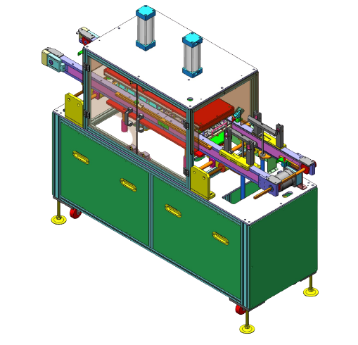
Program MCU inline, up to 4 MCU
Easy to use
High reliability
Accurate statistics
Programmed by DEV Engineers
Auto Multi Writing System

Slide 3
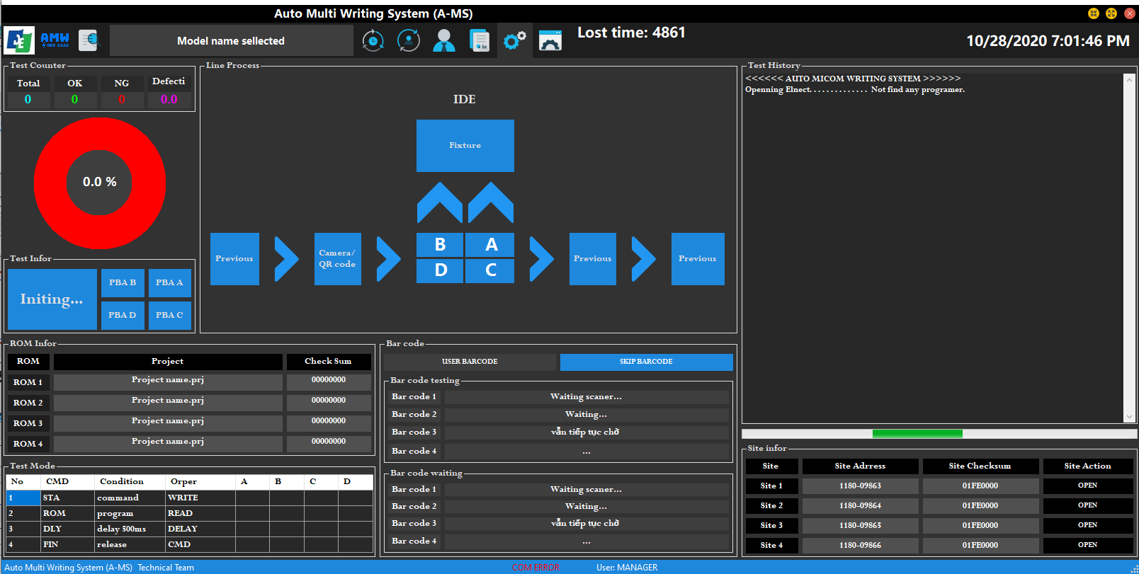
Software
sxdsadasdasd

